Slide 1
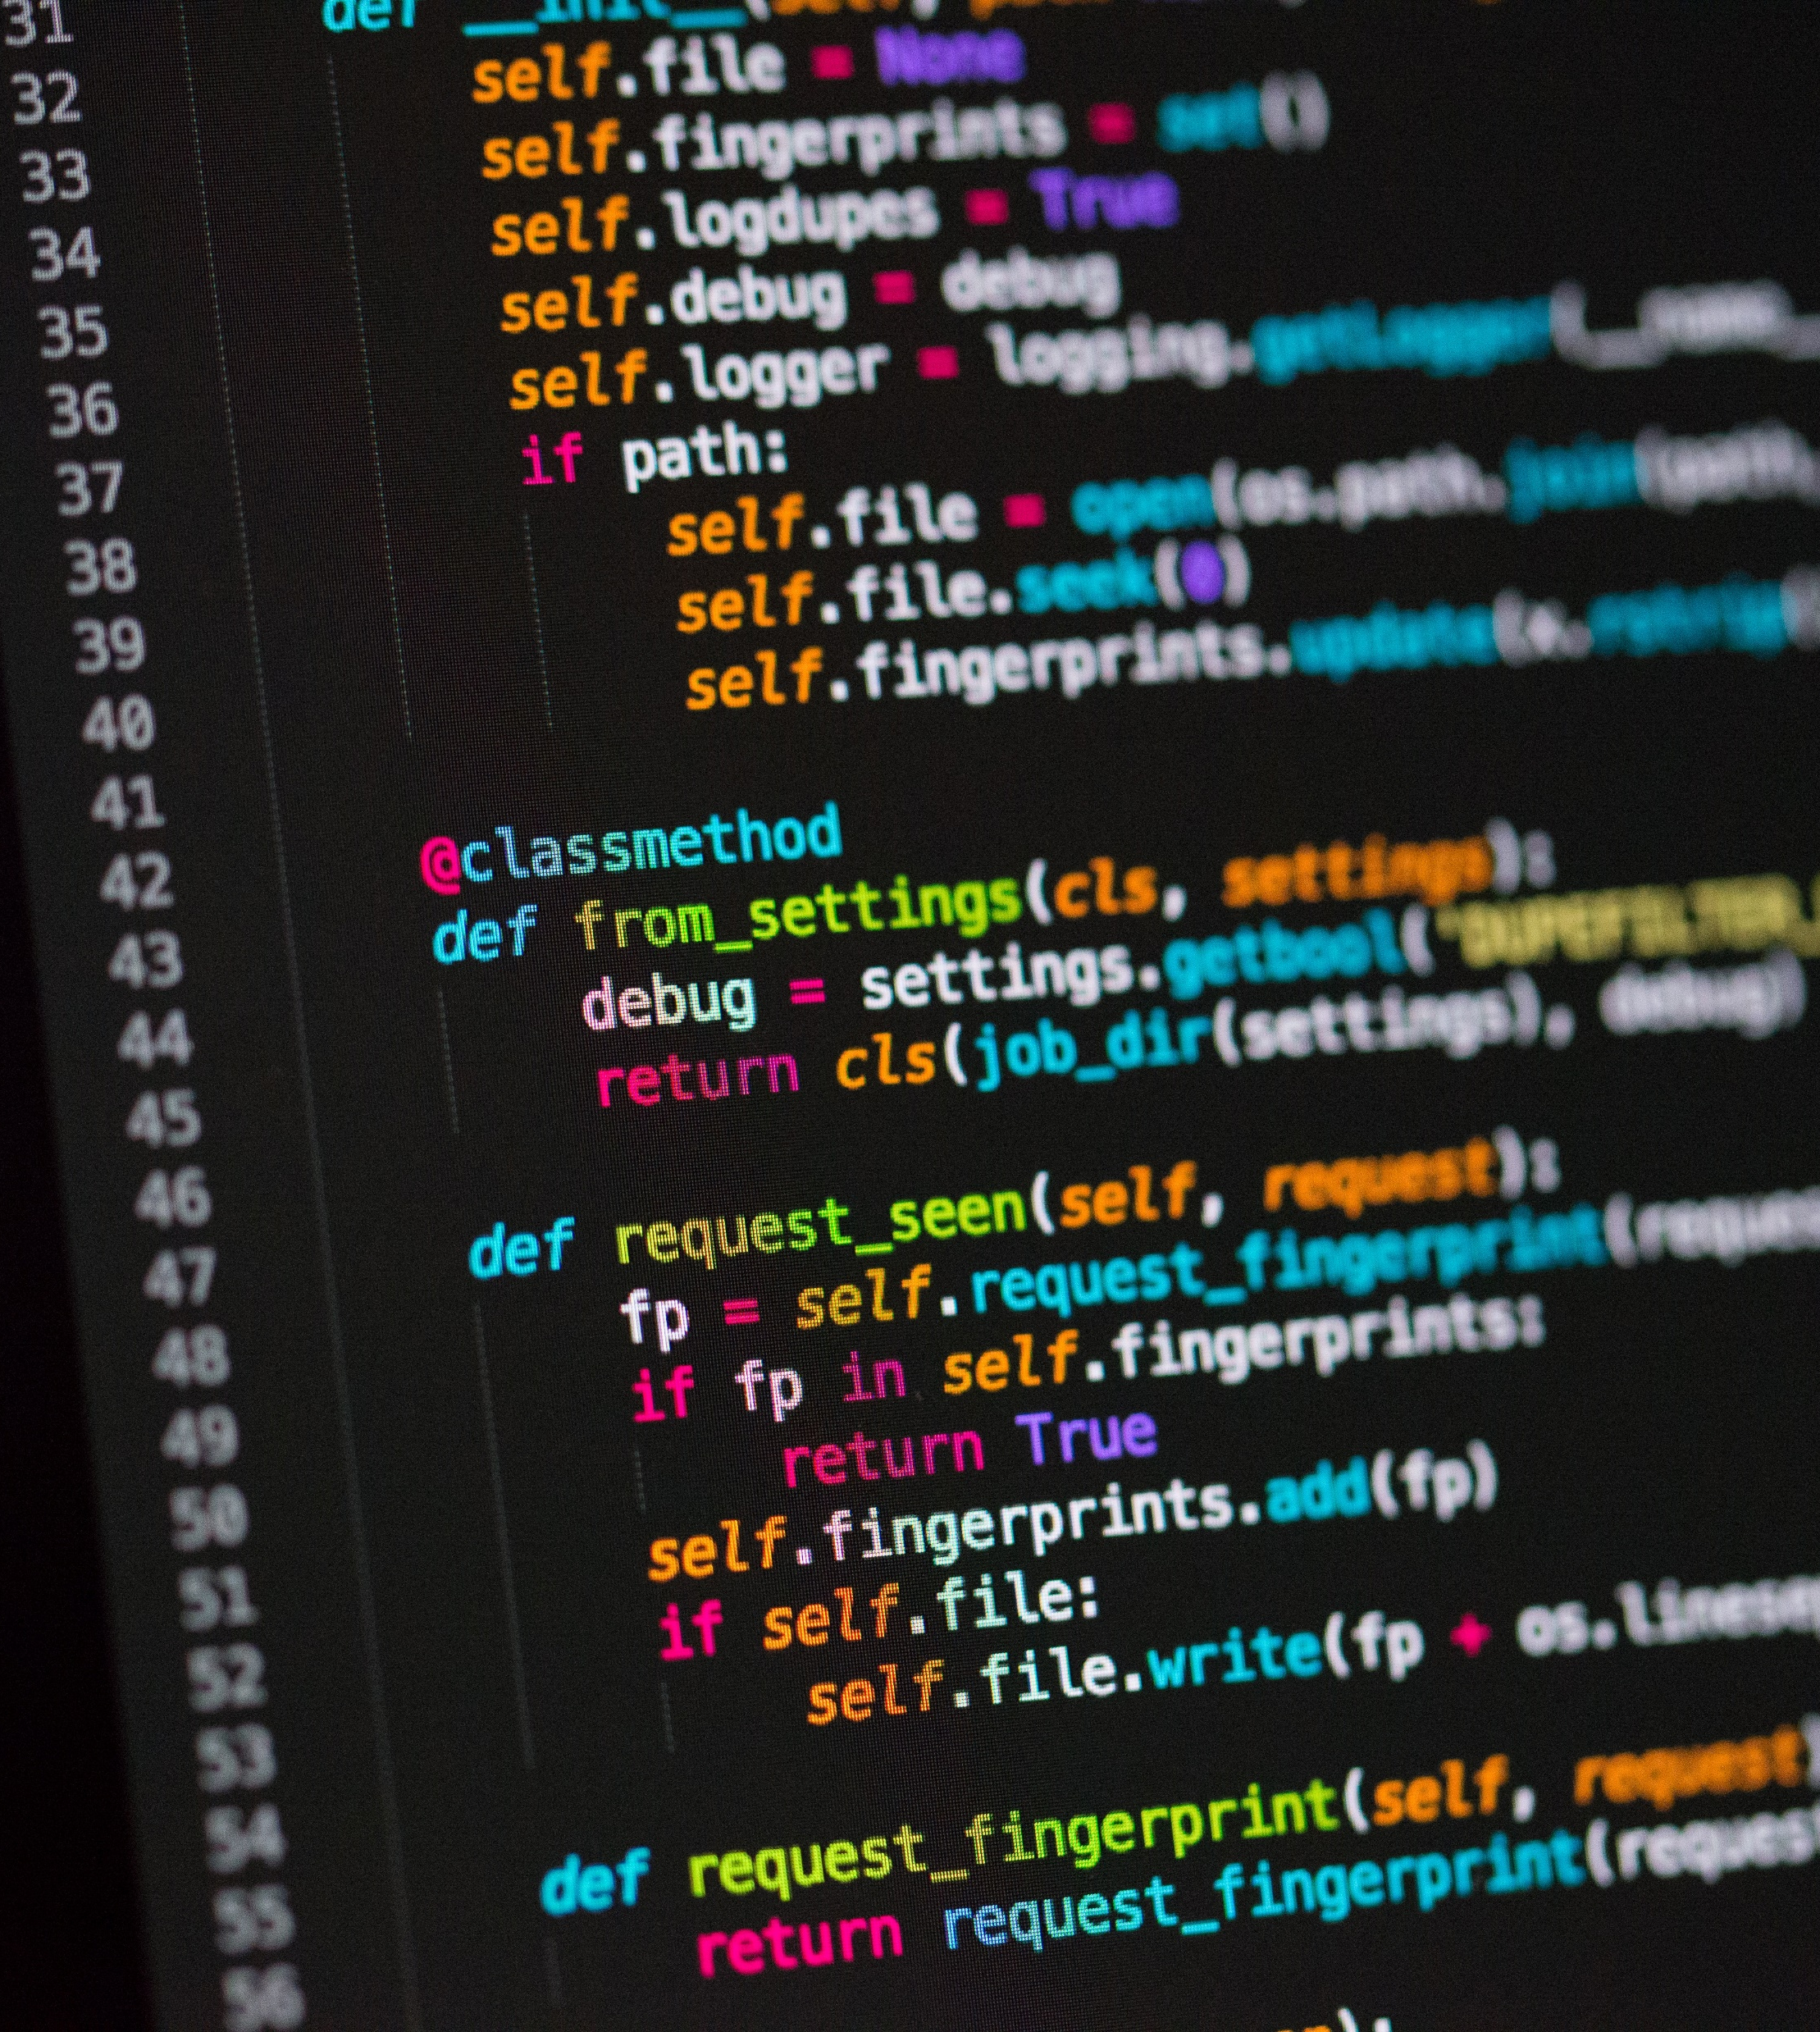

Between the Lines
“Understanding Emotions and Intentions Hidden in Text”
By: Judy Alhadid
Track: ML / Data Science

Slide 2
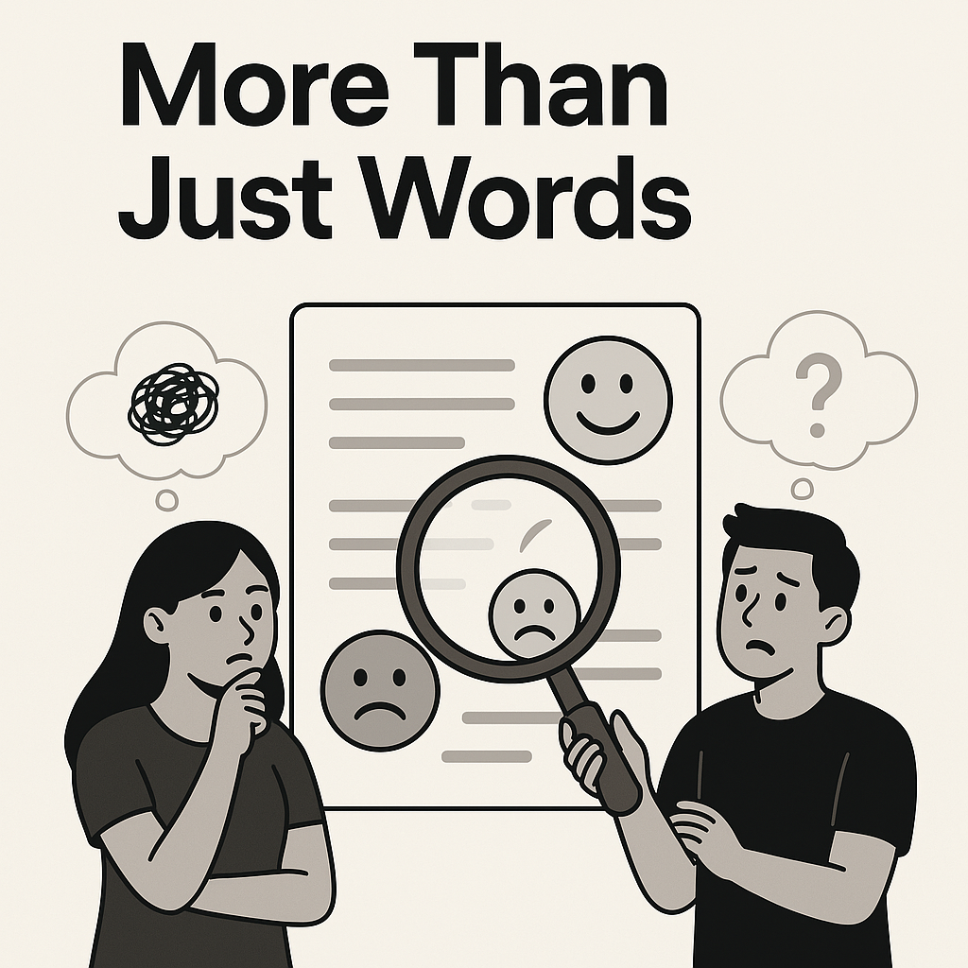
People often express themselves in ways that don’t fully show how they feel or what they really want. When we read messages, we might miss the real emotion behind the words. This can cause a huge misunderstandings.
Most current tools only say if a message is positive or negative, but they don’t go deeper!
We need a smarter way to understand what people truly feel so can we build a system that reads “between the lines” to uncover hidden feelings?

Slide 3
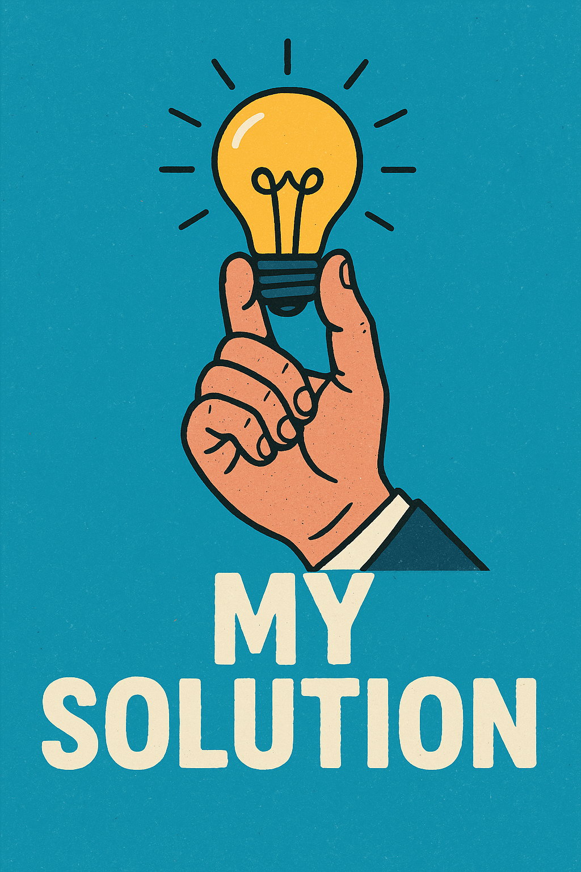
I built a smart tool that can understand both the feelings and the intentions behind any written text. Instead of just saying if a message is positive or negative, the model goes deeper. It can tell if someone is happy, sad, angry…
If I get the right support, I’ll be able to go deeper in understanding the text. This way, I’ll be able to tell if someone is asking a question, making a request, or expressing emotions like sadness or happiness. It will help us understand people better and respond in a more human way.

Slide 4
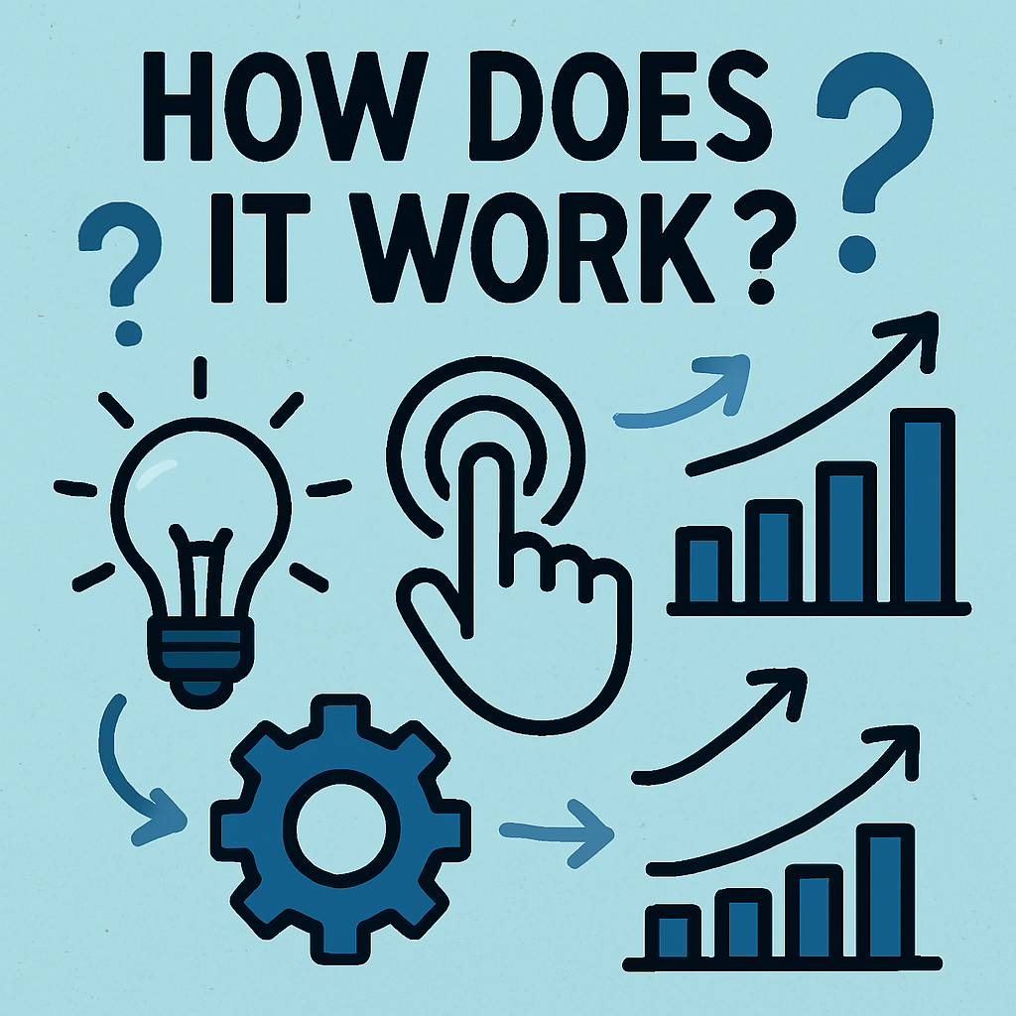
The App uses advanced AI to analyze text and detect emotions such as happiness, sadness, anger, and others. By looking at the words and structure of the text, it understands the emotional tone behind the message. This allows us to gain a deeper understanding of how the person is feeling and respond in a way that feels more human, and creating better communication.

Slide 5
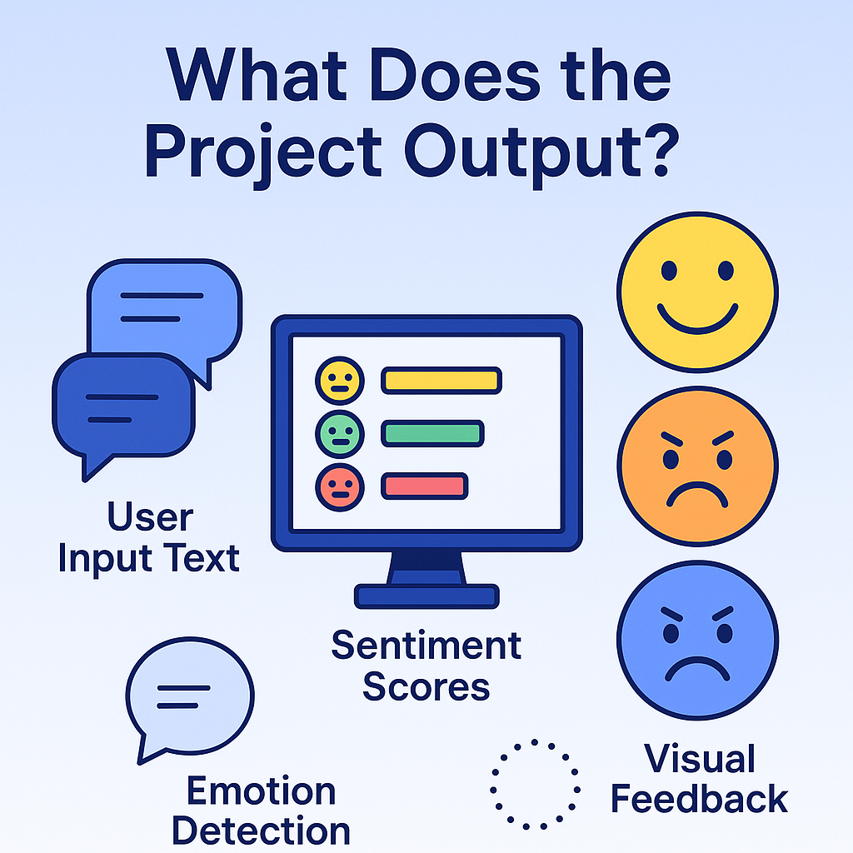
The project provides clear insights it can identify whether someone is feeling happy, sad, angry, or other emotions.
For example, when analyzing a customer review, the tool might detect the emotion as "disappointment“. This helps businesses respond appropriately and understand their customers better.

Slide 6
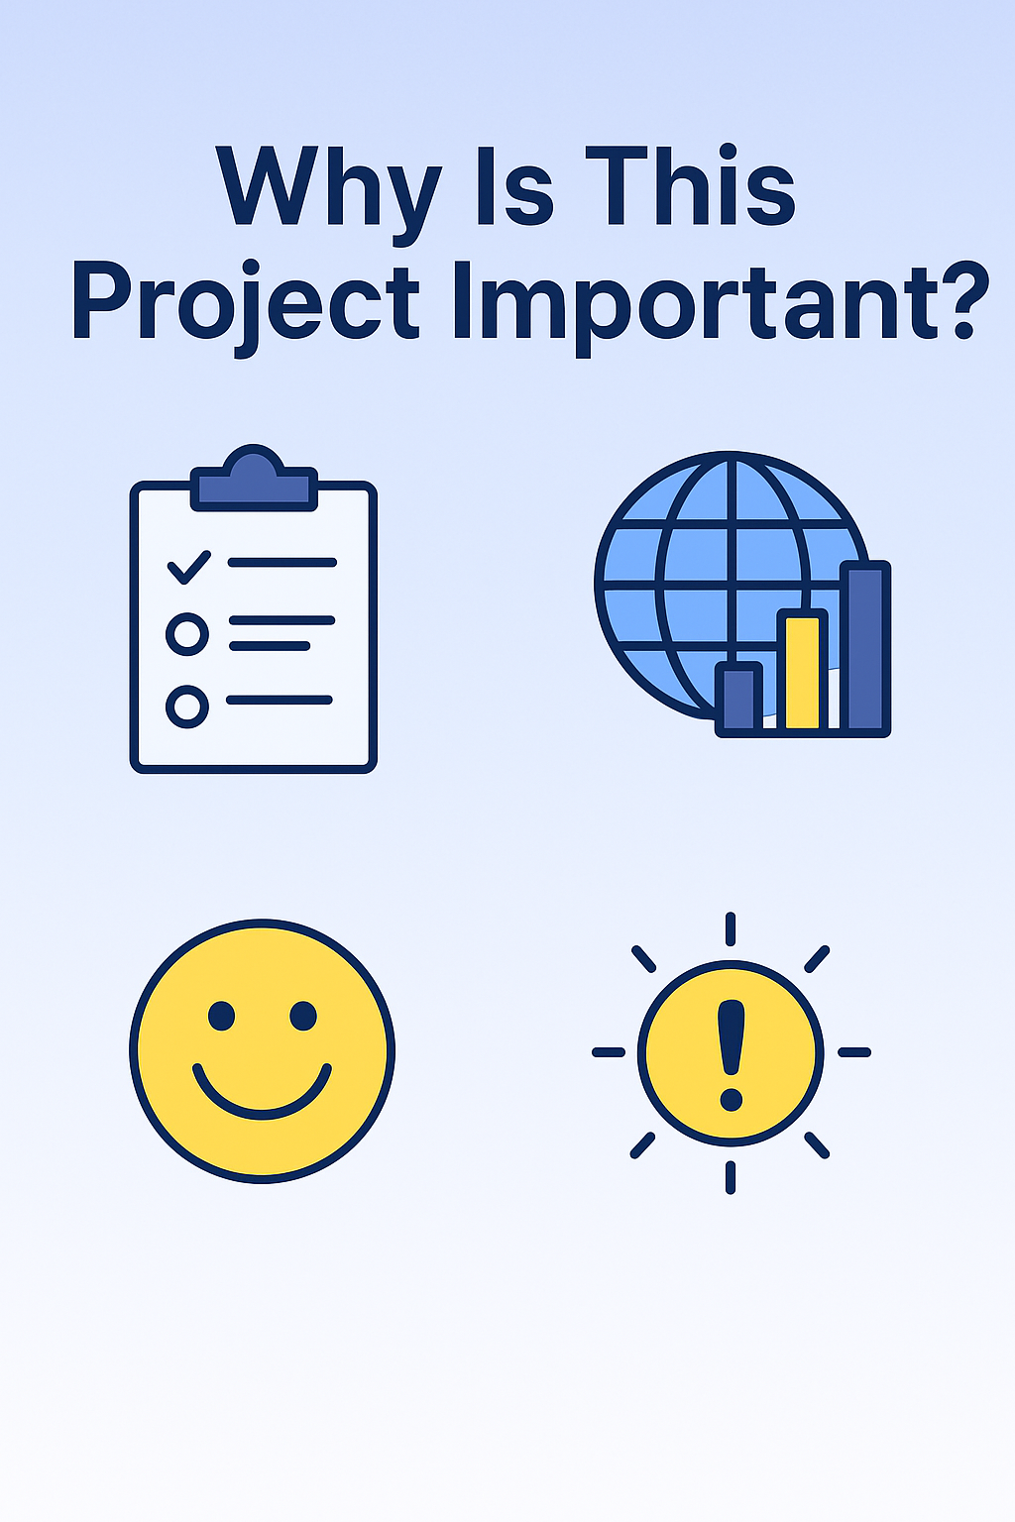
It’s useful for businesses to provide better customer service by quickly recognizing how customers feel and what they need. It also helps individuals communicate more clearly and thoughtfully.
The practical use of this tool will make users feel proud since it follows to their ethics and beliefs and makes sure it cannot be used in a detrimental or negative way. This leads to more meaningful and respectful interactions.

Slide 7
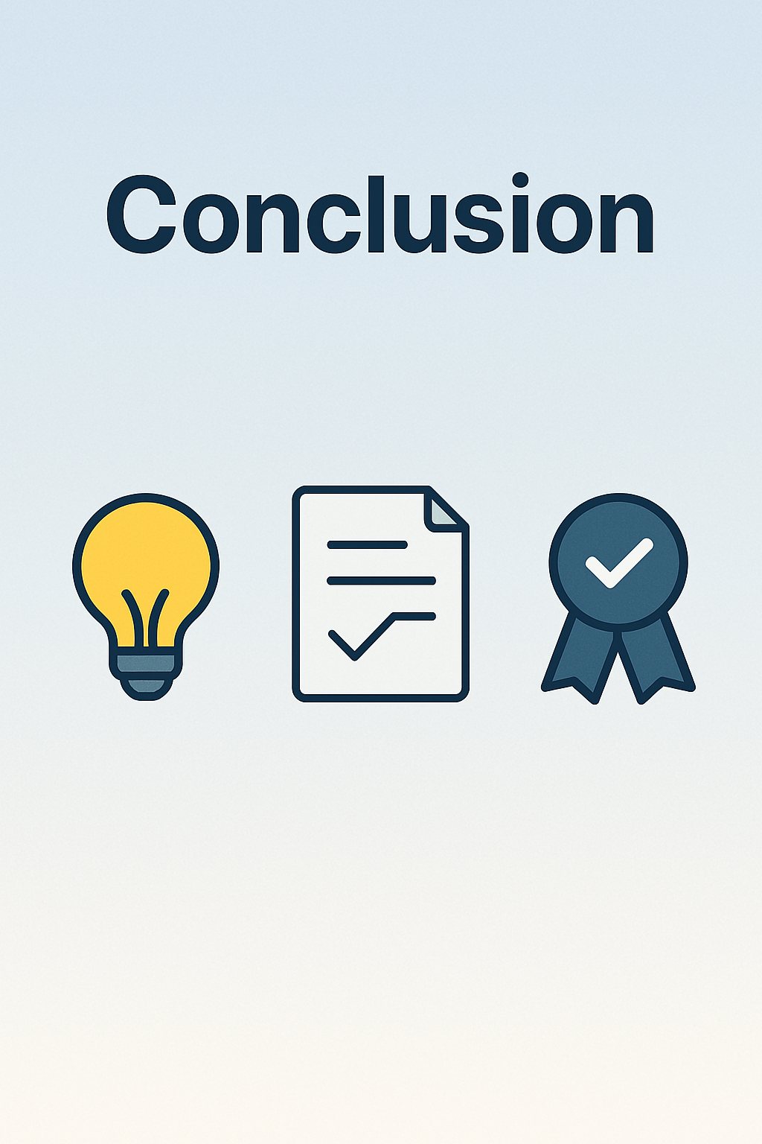
This project makes it easier to understand emotions and intentions in communication, helping create more meaningful interactions. I will keep improving the tool to make it more accurate and available for everyone, while always making sure it’s used in a positive and ethical way.

Slide 8
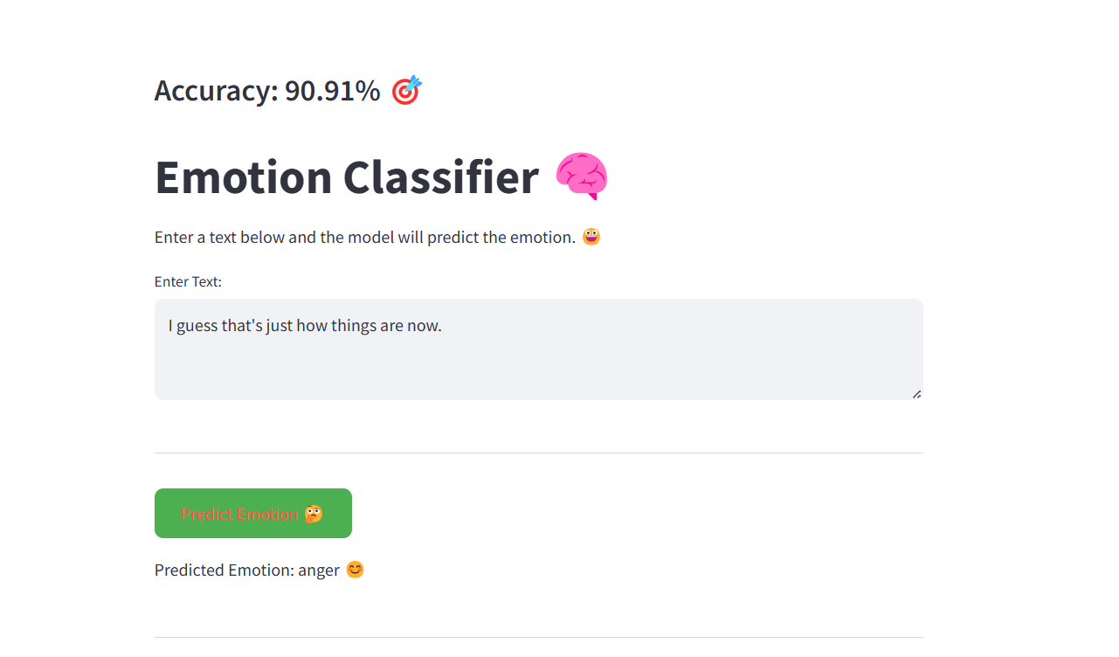

Slide 9
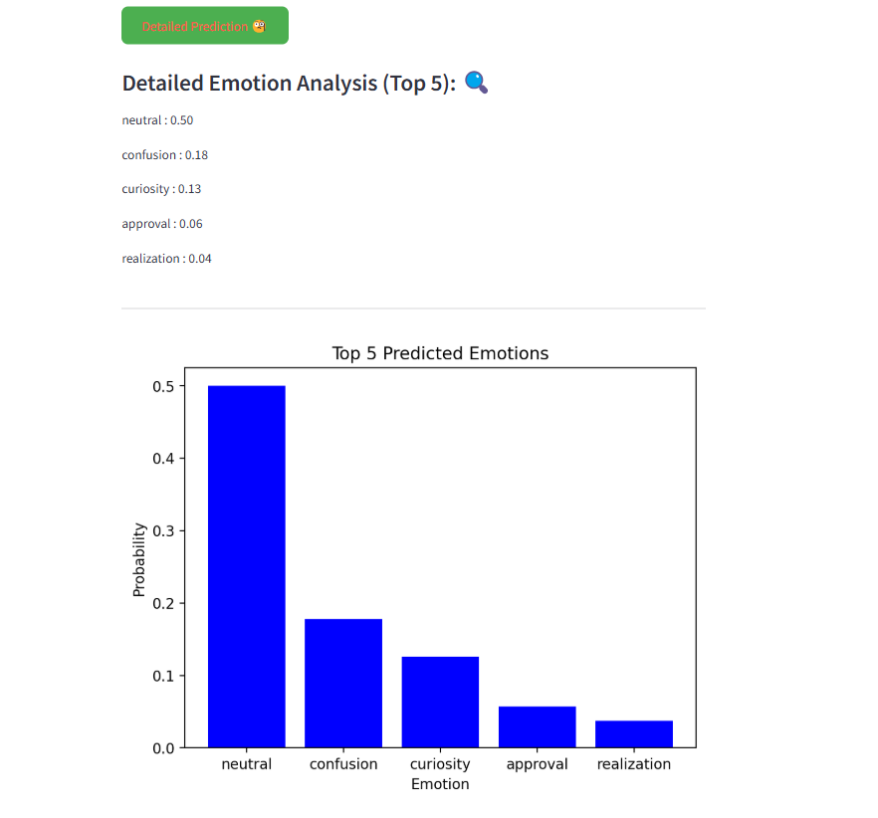

Slide 10
C:\Users\LENOVO\Desktop\project\Between the Lines.py

